Slide 1

Augmented Reality System for Architectural Visualization
DSA0216-Computer Vision with OpenCV for Modern AI
GUIDED BY
Dr. Senthilvadivu S
Dr. Kumaragurubaran T
PRESENTED BY
G .Rahul Reddy(192424266)
P .Siddardha(192424271)
S .Siva Sai Reddy(192424309)

Slide 2


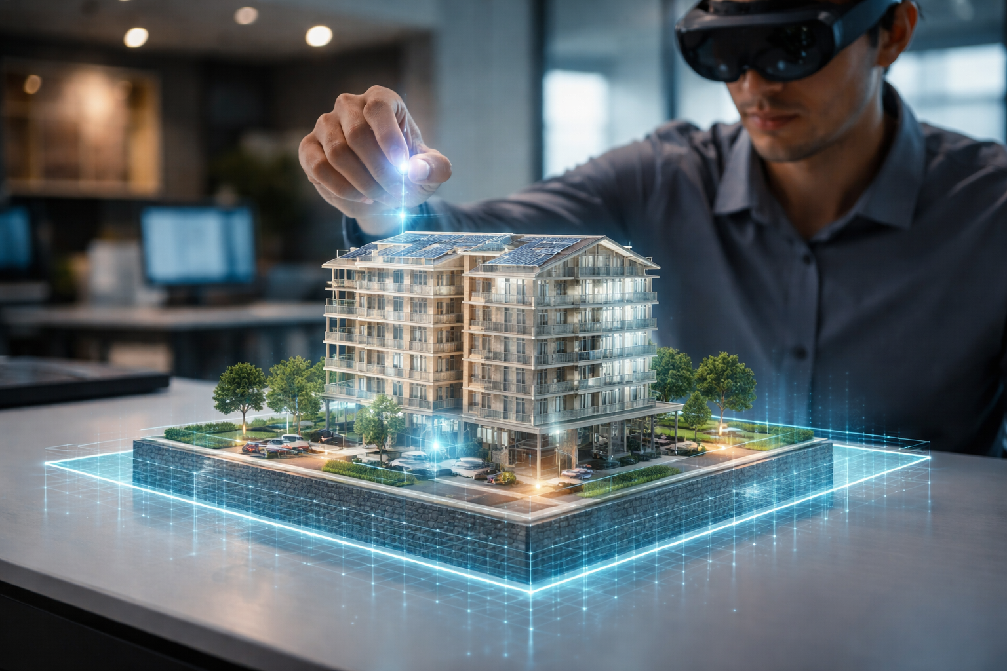
INTRODUCTION
An Augmented Reality (AR) System for Architectural Visualization allows architects, engineers, and clients to view 3D building models overlaid onto the real world using devices like smartphones, tablets, or AR headsets. Instead of imagining designs from 2D drawings, users can see, explore, and interact with virtual buildings in real environments. This system is commonly built using computer vision, 3D graphics, and AR frameworks such as OpenCV, ARCore, or ARKit.

Slide 3
OBJECTIVES
To develop an AR-based visualization system that enables users to view 3D architectural models in real-world environments using mobile devices.
To convert 2D architectural images into 3D visual representations using AI-based depth estimation techniques for improved design interpretation.
To provide interactive user controls for manipulating models through rotation, scaling, zooming, and color adjustment features.
To enhance communication and decision-making between architects, clients, and engineers by offering clear, immersive, and realistic design visualization.

Slide 4
LITERATURE REVIEW
S .No | Author(s) & Year | Focus Area | Methodology | Key Findings | Limitations | Relevance to Project
1 | Cloud-based AR Architecture (2025–2026) | AR System Architecture | Technical Framework Analysis | Hybrid cloud systems improve multi-user AR collaboration | Network latency | Useful for scalable AR architectural apps
2 | Song et al., 2021 | AR Technology Review | Comprehensive Survey | AR enhances spatial understanding and real-time interaction | Hardware & tracking limitations | Helps justify AR for immersive building visualization
3 | Boboc et al., 2022 | AR in Cultural Heritage | Review + Case Studies | AR effectively overlays reconstructed models onto real environments | Environmental lighting affects tracking | Useful for overlaying architectural 3D models onto real sites
4 | Integration of AR & BIM Studies (2023–2025) | AR + BIM Integration | Experimental & Industry Analysis | BIM models can be visualized on-site using AR, reducing rework | Heavy BIM models need optimization | Important for integrating architectural CAD/BIM models
5 | AR in Architectural Education (2024) | Design Learning & Visualization | Systematic Review | Students understand scale & spatial depth better using AR | Learning curve for tools | Supports AR-based design visualization tools

Slide 5
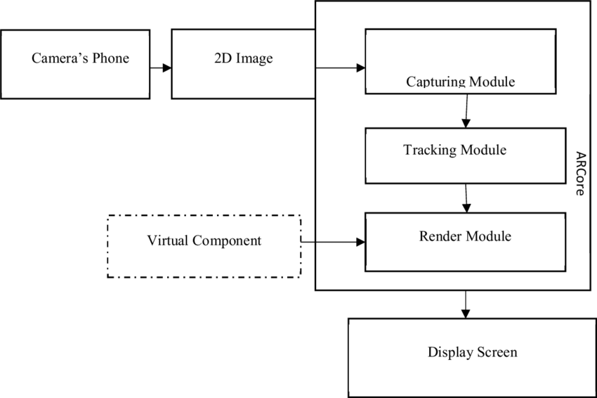
Architecture Diagram

Slide 6
MODULE 1 -Real World Scene Mapping
This module helps the AR system understand the real environment using the device camera.
The camera scans the surrounding area and identifies flat surfaces like floors, tables, or walls.
It detects feature points (small dots in the scene) to understand depth, distance, and shape of the surface.
Real-world scene mapping uses SLAM (Simultaneous Localization and Mapping) to track the device’s position and build a 3D map of the environment.
ARCore or ARKit frameworks help the system recognize surfaces and anchor virtual objects onto them.

Slide 7
MODULE 2 -3D Architectural Model Rendering
This module is responsible for displaying the 3D architectural model inside the real-world scene detected in Module 1.
Once a surface is found, the 3D building model is placed on that surface as if it physically exists there.
The system loads a digital 3D model (house, room, building, wall design) created using tools like Blender, SketchUp, or Unity.
The rendering system shows the model with proper shape, size, textures, and materials.
Lighting effects are applied so that the model looks realistic with shadows and brightness matching the real environment.

Slide 8
MODULE 3 - User Interaction & AR Visualization Controls
Allows users to rotate, zoom, and move 3D architectural models in real time, improving understanding of the design.
OpenCV processes live camera input to detect gestures, motion, or touch-based interactions.
Interactive controls make architectural visualization more intuitive, realistic, and user-friendly.
Includes gesture-based, touch-based, and input-device-based controls for flexible AR interaction.
Helps architects and clients analyze designs, identify issues, and make decisions before construction.

Slide 9
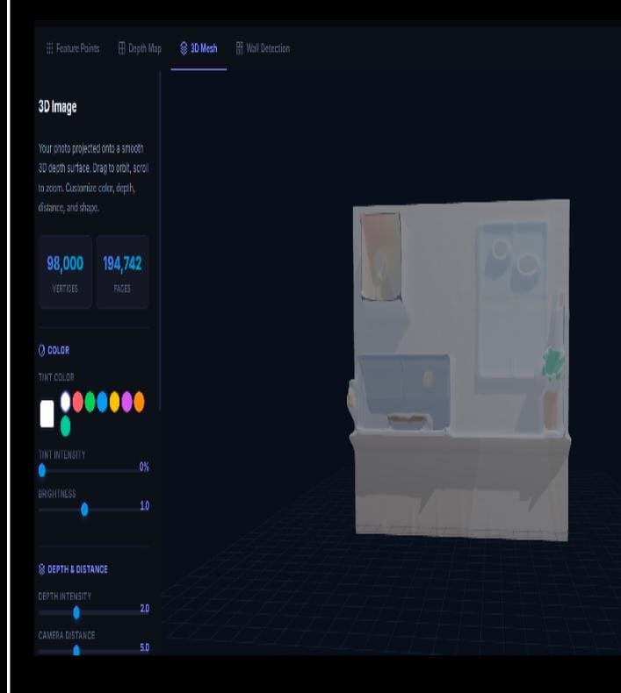
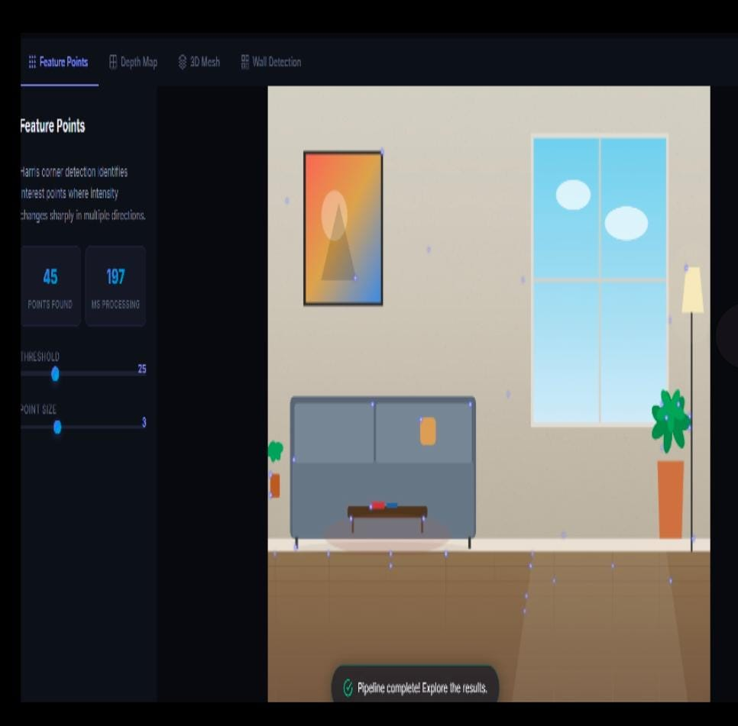
Implementation

Slide 10
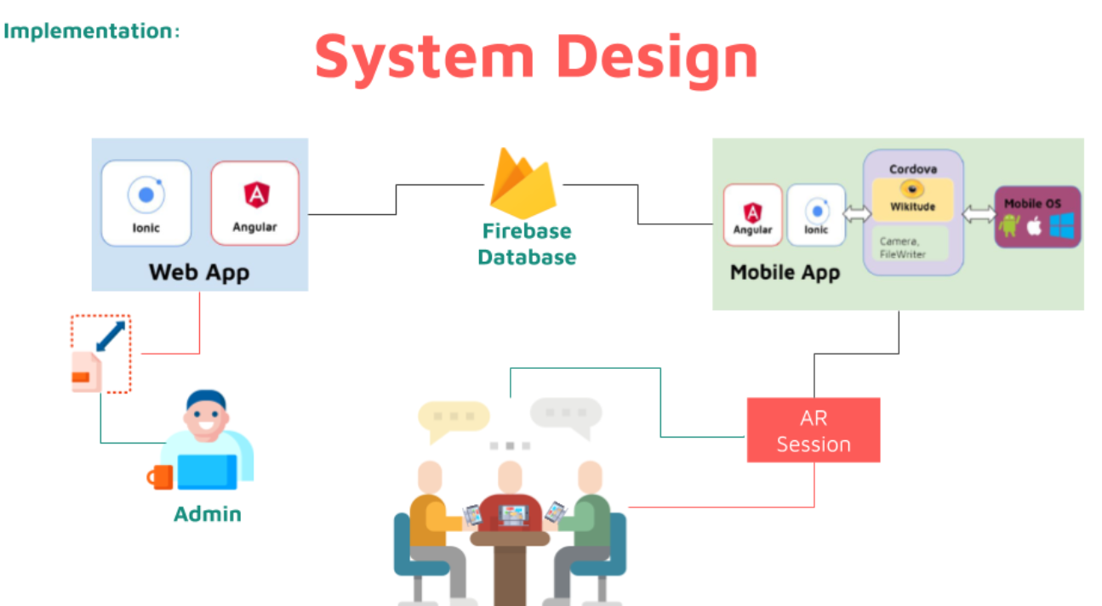
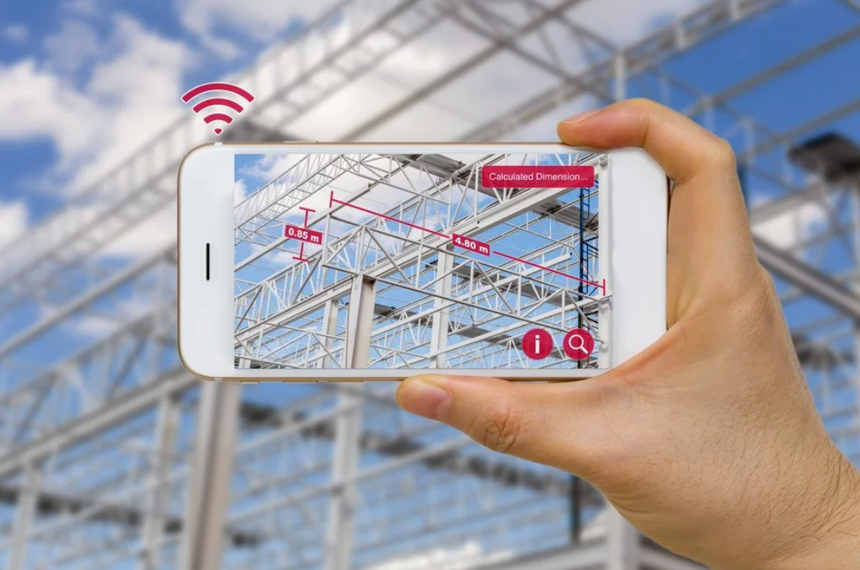
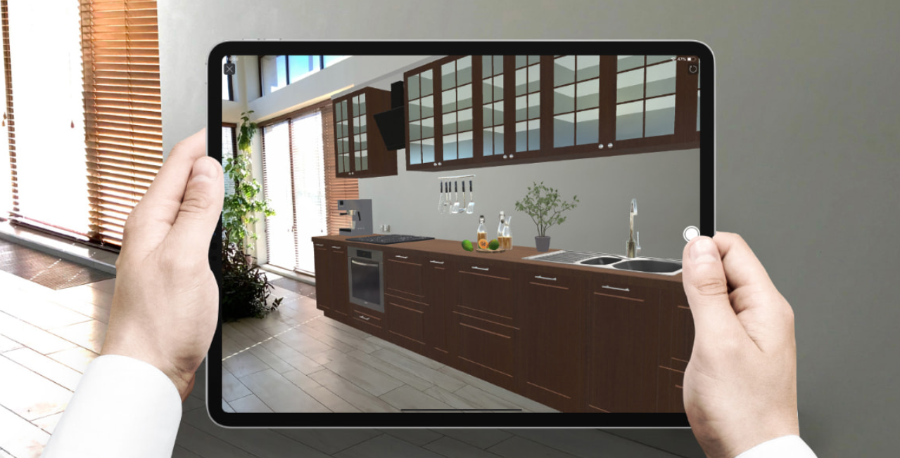
Results and Discussion
The Augmented Reality system worked successfully by showing 3D building models on top of the real environment using a mobile device. Users could place the virtual building on the floor or a table, move it, rotate it, and walk around it as if the structure were actually there. This made it much easier to understand the size, shape, and layout of the building compared to looking at drawings or normal 3D images. Many users said they could quickly notice design problems, such as room size issues or awkward spaces, before construction even started.

Slide 11

Future Scope
The future scope of an Augmented Reality system for architectural visualization is extremely promising as emerging technologies continue to enhance how buildings are designed, constructed, and managed. In the coming years, AR systems will be integrated with artificial intelligence, digital twins, and Building Information Modeling (BIM) to provide real-time design optimization, clash detection, and performance analysis. These systems will allow architects and planners to visualize smart cities, simulate environmental impacts, and evaluate energy efficiency before construction begins.

Slide 12
CONCLUSION
The Augmented Reality (AR) system for architectural visualization provides an innovative and interactive way to present building designs in real-world environments. By using technologies such as surface detection, SLAM-based tracking, and real-time 3D rendering, the system allows architectural models to be accurately placed and viewed on physical surfaces like floors and walls. Users can walk around the virtual structure, observe it from different angles, and better understand the scale and appearance of the design before construction begins. As AR hardware and software technologies continue to evolve, such systems are expected to become more accurate, accessible, and widely adopted in the architecture and construction industry.

Slide 13
References
C. Eastman, P. Teicholz, R. Sacks, and K. Liston, BIM Handbook: A Guide to Building Information Modeling, 2nd ed., Wiley, 2023.
C. Moscoso, “Increasing Citizen Engagement in Sustainable Architecture Through Augmented Reality,” Sci. Direct, 2024.
V. Alekhya, “Integrating Augmented Reality in Architectural Design,” E3S Web Conf., 2024.
S. M. Halıcı, “AI-based Augmented Reality for Architectural Mass Study,” SpringerLink, 2025.
S. Arvikar, “Augmented Reality-based Construction Site Management System Integrating BIM for Real-Time Progress Tracking,” Sci. Direct, 2025.
N.-H. Pan and N. N. Isnaeni, “Integration of Augmented Reality and Building Information Modeling for Enhanced Construction Inspection — A Case Study,” Buildings, vol. 14, no. 3, 2024.

Slide 14


